Slide 1
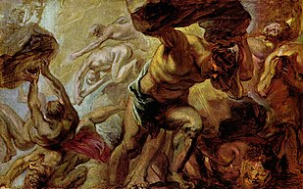
THE CREATION OF THE WORLD
TITANOMACHY

Slide 2
In the beginning there was chaos…

Slide 3

From chaos
the Earth was born

Slide 4
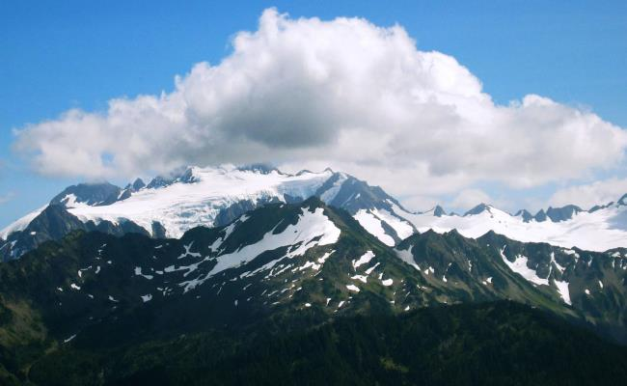


The Earth gave birth to the mountains, the sea and Uranus who was the first god

Slide 5
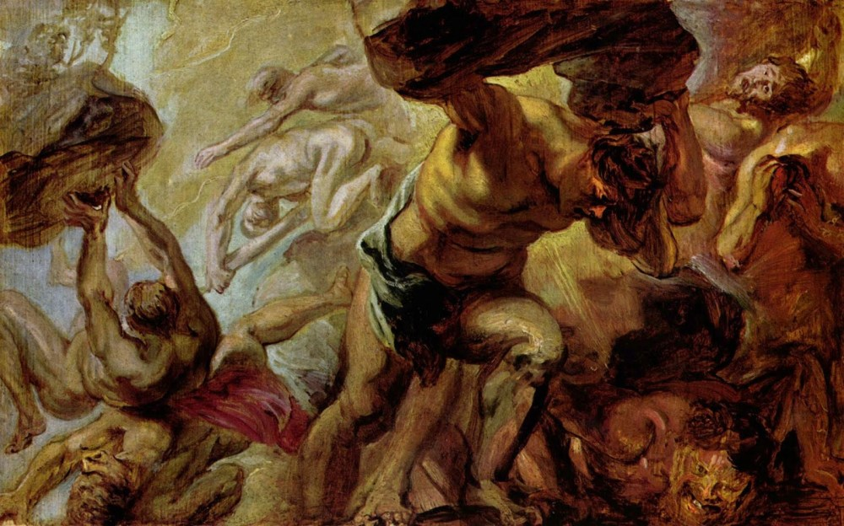
Uranus and Earth gave birth to 13 children, the
Titans.

Slide 6
But his youngest child, Cronus, escaped with the help of his mother and took the throne from him.
However, Uranus feared that one day,
one of his children would take the
throne from him. In order none of
his children to take the throne, he
threw them in a deep cave.

Slide 7
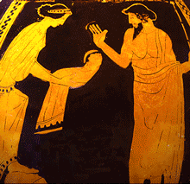
Cronus had the same fear as his father, he feared that his children would do the same thing as he did to his father.
So when his wife Rhea was giving birth to a child, Cronus devoured it.
But one day Rhea tried to save her sixth child.
His name was Zeus.Rhea ,in order to save her child,
gave Cronus a stone to eat.

Slide 8
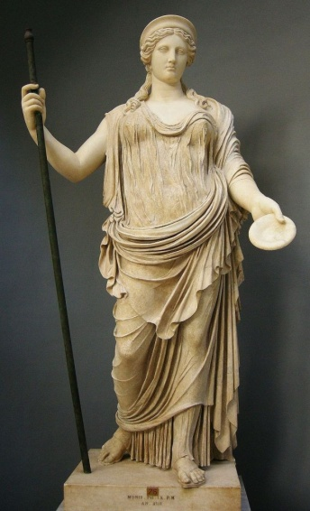
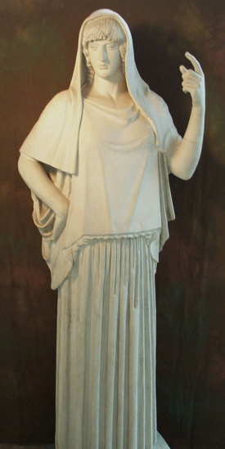
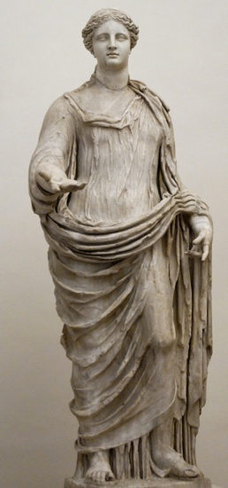
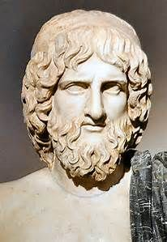
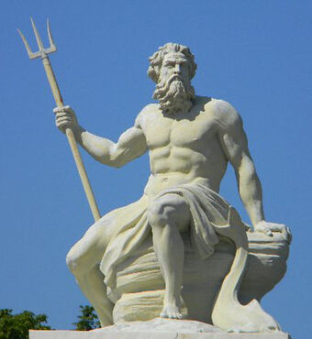
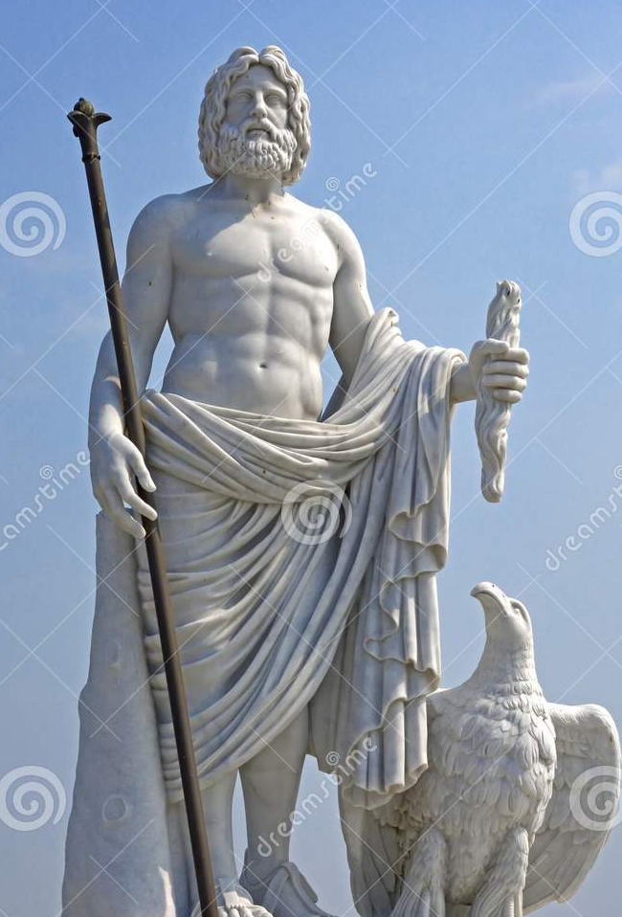
Zeus was brought up by the nymphs and a goat in a cave on a mountain in Crete.
When Zeus grew up, he returned back to save his
siblings. With his brothers’ and sisters’ help
he managed to take the throne from his father.
CRONUS+RHEA
Hera
Hestia
Demeter
Pluto
Poseidon
Zeus

Slide 9
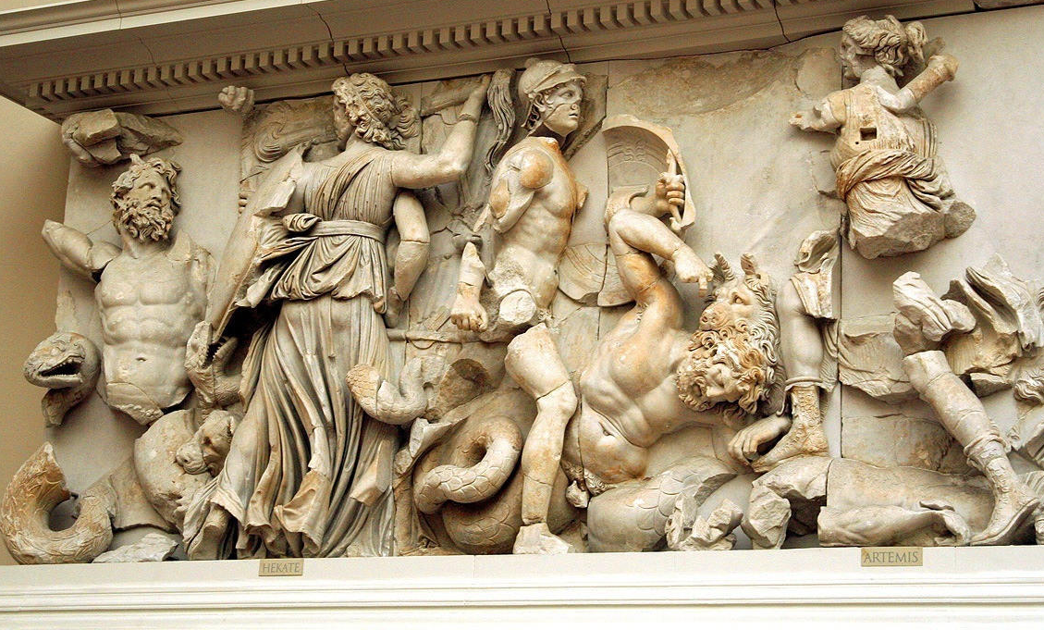
Then a great war began between Cronus and Zeus that lasted for 10 years. Cronus had the
Titans on his side, while Zeus was supported by his siblings and three giants who had 100 hands each.
This battle is known as Titanomachy.

Slide 10
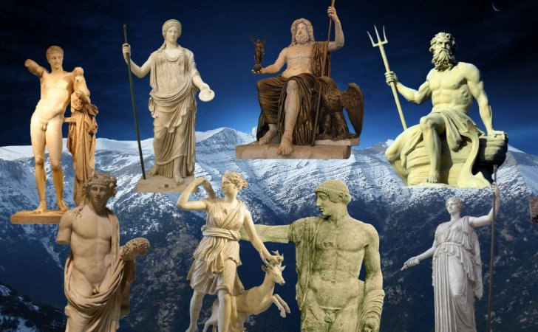
At Titanomachy the world was divided into three parts.
Zeus got the sky, Poseidon the sea and Pluto, or Hades, the underworld. Zeus and his siblings lived on the mountain Olympus.

